Slide 1
DATA SCIENCE IN SPORTS
Group Members: Ghizlane Rehioui
Yashwanth Reddy T
Taahaa Dawe
Dhruv Gupta

Slide 2
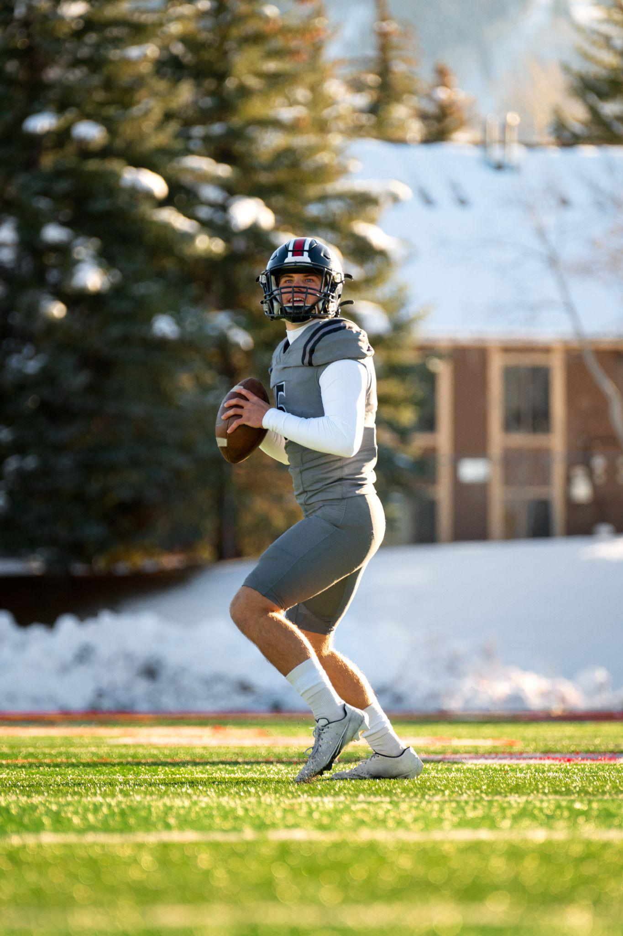
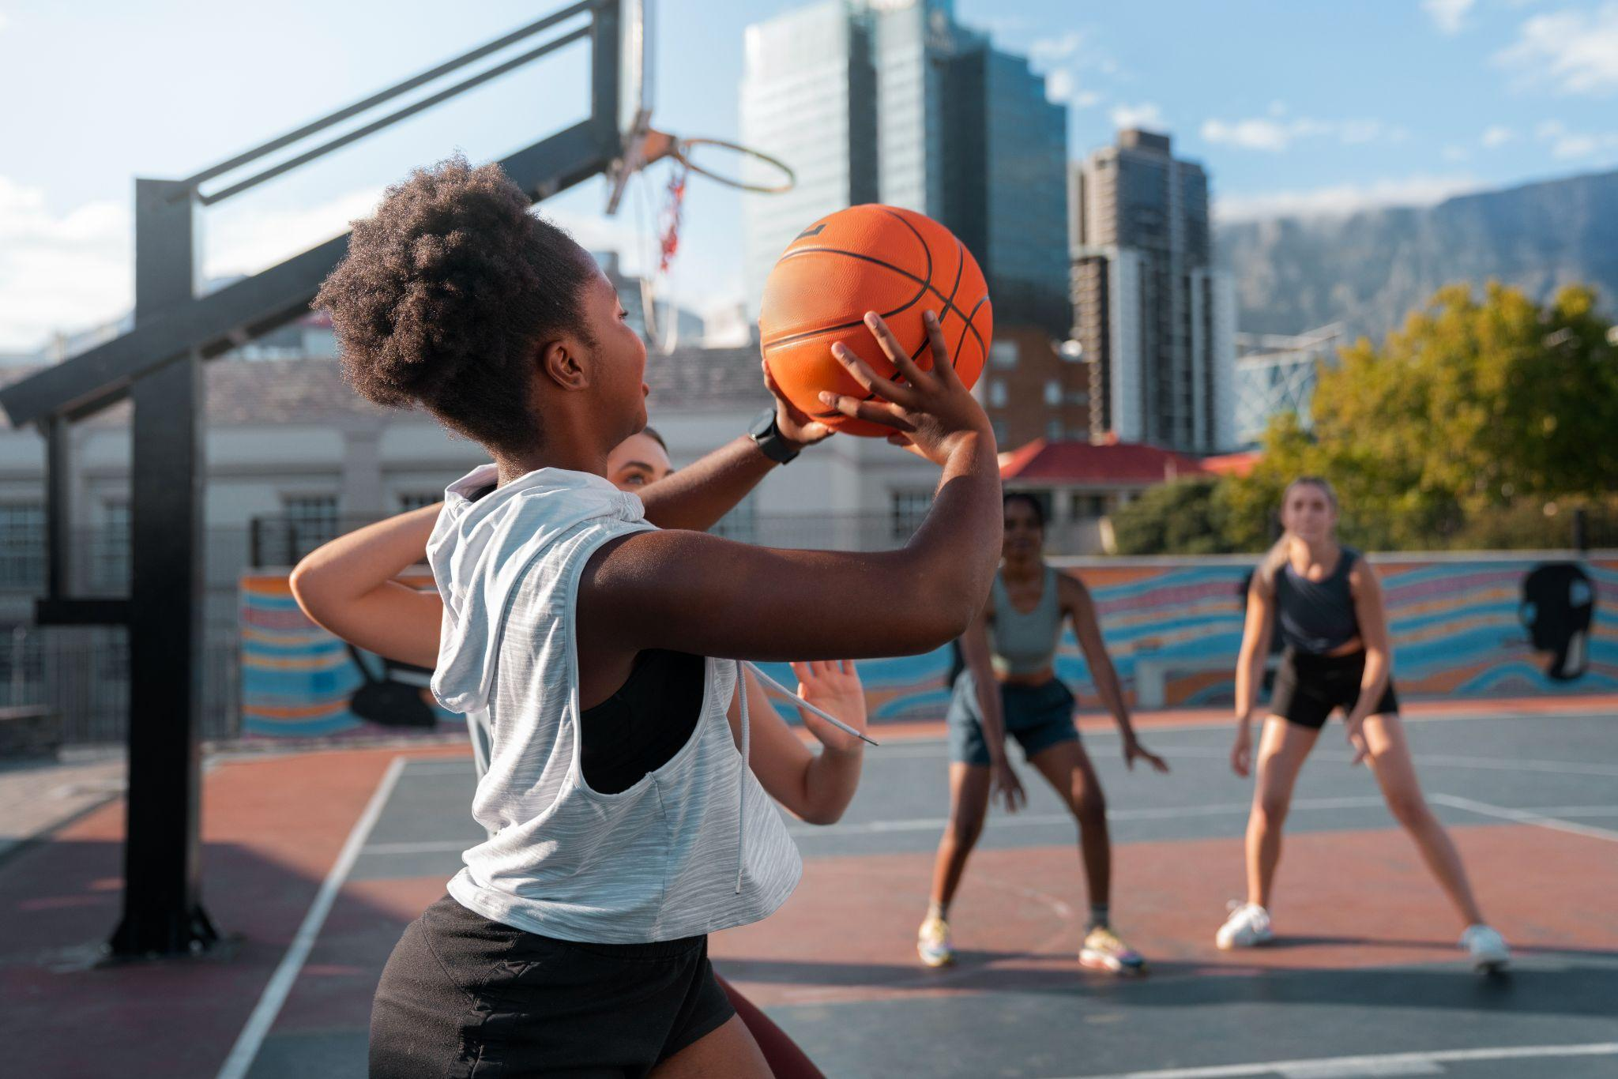
Domain Area
Sports Analytics
Notes:
Main Questions:
What goals can data science help achieve? (e.g. drive user engagement or predict election results or optimize crop yield)
What are some of companies/research groups working in this area?
How are they using data science?
What is a typical day-to-day of a data scientist in this domain
What are the skills that a data scientist should have when working in this domain?
What are some elective courses that a students interested in this domain could take at CU? (I strongly suggest you include this question)
Detail
What goals can data science help achieve? (e.g. drive user engagement or predict election results or optimize crop yield)
1. How is data science and analytics being used in the world of sports? Can you provide examples of how data has transformed decision-making in sports
Health and performance
Financing
Scouting
Add examples
2. How do sports analytics influence game strategy and in-game decision-making for coaches and players? Can you provide specific examples?
3. How do sports analytics contribute to player development and injury prevention in youth sports and amateur leagues?
4. How do sports teams use analytics to scout and recruit players? What role does data play in player selection and development?
5. What are the benefits of using player tracking technology, like GPS and wearables, in sports analytics? How does it help improve athlete performance and prevent injuries?
6. Are there specific trends in sports analytics, such as the use of AI and machine learning for predicting game outcomes or player performance?
7. How do sports analytics impact fan engagement and the viewer experience, both in stadiums and through media broadcasts?
What are some of companies/research groups working in this area?
1. Are there any ongoing research projects or collaborations between academic institutions and sports organizations in the field of sports analytics?
2. How are they using data science?
What is a typical day-to-day of a data scientist in this domain
What are the challenges and ethical considerations associated with collecting and using player data in sports analytics?
Articles and interviews
What skills are essential for a data scientist or analyst working in sports analytics?
Are there any specialized tools or software commonly used in this field?
How can aspiring data scientists or students interested in sports analytics get involved in this field?
What are some elective courses that a students interested in this domain could take at CU or elsewhere?
What are some elective courses that a students interested in this domain could take at CU?
What are some elective courses that a students interested in this domain could take at elsewhere?

Slide 3
TABLE OF CONTENTS
01
02
03
04
How DS in SA?
DS Responsibilities
Challenges
Skills & Tools

Slide 4
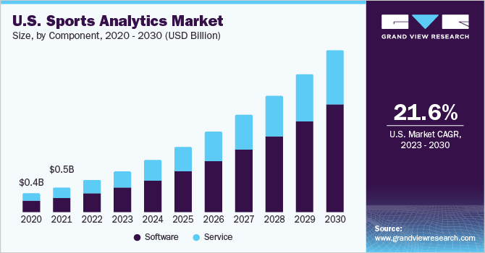
Domain Area: Sports Analytics
https://www.grandviewresearch.com/industry-analysis/sports-analytics-market
Notes:
In fact, it’s expected that the Sports Data Analytics market is going to reach upwards of $4.5 billion by 2025. - by the time we graduate
Main Questions:
What goals can data science help achieve? (e.g. drive user engagement or predict election results or optimize crop yield)
What are some of companies/research groups working in this area?
How are they using data science?
What is a typical day-to-day of a data scientist in this domain
What are the skills that a data scientist should have when working in this domain?
What are some elective courses that a students interested in this domain could take at CU? (I strongly suggest you include this question)
Detail
What goals can data science help achieve? (e.g. drive user engagement or predict election results or optimize crop yield)
1. How is data science and analytics being used in the world of sports? Can you provide examples of how data has transformed decision-making in sports
Health and performance
Financing
Scouting
Add examples
2. How do sports analytics influence game strategy and in-game decision-making for coaches and players? Can you provide specific examples?
3. How do sports analytics contribute to player development and injury prevention in youth sports and amateur leagues?
4. How do sports teams use analytics to scout and recruit players? What role does data play in player selection and development?
5. What are the benefits of using player tracking technology, like GPS and wearables, in sports analytics? How does it help improve athlete performance and prevent injuries?
6. Are there specific trends in sports analytics, such as the use of AI and machine learning for predicting game outcomes or player performance?
7. How do sports analytics impact fan engagement and the viewer experience, both in stadiums and through media broadcasts?
What are some of companies/research groups working in this area?
1. Are there any ongoing research projects or collaborations between academic institutions and sports organizations in the field of sports analytics?
2. How are they using data science?
What is a typical day-to-day of a data scientist in this domain
What are the challenges and ethical considerations associated with collecting and using player data in sports analytics?
Articles and interviews
What skills are essential for a data scientist or analyst working in sports analytics?
Are there any specialized tools or software commonly used in this field?
How can aspiring data scientists or students interested in sports analytics get involved in this field?
What are some elective courses that a students interested in this domain could take at CU or elsewhere?
What are some elective courses that a students interested in this domain could take at CU?
What are some elective courses that a students interested in this domain could take at elsewhere?

Slide 5
01
How is Data Science helpful in Sports Analytics?
Notes:
What goals can data science help achieve? (e.g. drive user engagement or predict election results or optimize crop yield)
1. How is data science and analytics being used in the world of sports? Can you provide examples of how data has transformed decision-making in sports
Health and performance
Financing
Scouting
Add examples
2. How do sports analytics influence game strategy and in-game decision-making for coaches and players? Can you provide specific examples?
3. How do sports analytics contribute to player development and injury prevention in youth sports and amateur leagues?
4. How do sports teams use analytics to scout and recruit players? What role does data play in player selection and development?
5. What are the benefits of using player tracking technology, like GPS and wearables, in sports analytics? How does it help improve athlete performance and prevent injuries?
6. Are there specific trends in sports analytics, such as the use of AI and machine learning for predicting game outcomes or player performance?
7. How do sports analytics impact fan engagement and the viewer experience, both in stadiums and through media broadcasts?

Slide 6
THREE MAIN GOALS
01
02
03
Player & Game Performance
Player Health & Injury Analytics
Business Analytics
Performance evaluation of player with the goals of:
Best possible players
Best possible line-up
Best decisions on field
Injury prevention to overcome:
Team performance cost
Financial cost
Analytical operations concerning:
Strategically adapt the ticket prices
Increase fan engagement
Notes:
Other for business: ticket pricing, fan loyalty, promotions, social media, and fan engagement.

Slide 7
01
Player & Game Performance
Performance data allow us to:
Appropriately evaluate players
Identify the required skill set
Quantify player’s relative importance to team’s success
Develop data-based models for player scouting
Simulate games or by analyze game tactics
Notes:
Performance data allow us to:
Appropriately evaluate players
Identify the required skill set -- manage team’s budget and invest it in players who better fit their team
Quantify the relative importance of players to team’s success - can serve as a foundation of salary optimization AND (fair distribution of the disponible salary budget)
Develop player scouting data-based models -- by including in the player evaluation process parameters such as the number of games, goals, assists, passes, challenges, dribbles, shots, tackles, and crosses.
--
Determining the spatial configuration and the formation of the team during different phases of a match is one of the most important tactical decisions that football managers must make
In order to analyze the different possible team formations for games and outline their differences and advantages, new techniques based on analytical operations and the use of DTs are developed
Data collection through locational, biometric, and video data is gaining more and more importance in today’s football business and is enabled and facilitated using DTs and third-party data providers
Using locational and biometric devices include using data generated by GPS devices, radio frequency devices (RFID), or accelerometers
→ DS is supporting human-based scouting with data-based processes - leading to more reasonable and more accurate results.
More advanced analytical methods in this area include, for example, analytics on video data, open data analysis by fans (Gaughan, 2021), and gathering and using proprietary data, which can lead to substantive advantages compared to the competitor’s teams
********************************************
OTHER NOTES :
Useful for player scouting, and lineups/team strategies
Data based models use - Exemplary - parameters to be included in the player evaluation process are the number of games, goals, assists, passes, challenges, dribbles, shots, tackles, and crosses.
More advanced analytical methods in this area include, for example, analytics on video data, open data analysis by fans (Gaughan, 2021), and gathering and using proprietary data, which can lead to substantive advantages compared to the competitor’s teams
Includes scouting (only the best players are chosen to be part of the team), game strategy,
player scouting applications, and applications related to lineups and team strategies
evaluating player performance with the goals of selecting the best players, deciding on the best possible line-up, and making the best possible decisions on the field.
appropriate player valuation
Identification of the required skillset
applications related to lineups and team strategies!
→ DS is supporting human-based scouting processes with technology and data-based processes - coming up with more reasonable and more accurate results.
Performance Analytics on an individual player level can serve as a foundation of salary optimization
quantification of the relative importance of different players to a team’s success

Slide 8
Game Strategy & Decision-Making Impact
Performance
Analysis
Game Situation Analysis
Injury
Prevention
Substitution Strategies
Pitch
Selection
Situational Awareness
Play
Calling
Fan
Engagement
Strategic Timeouts

Slide 9
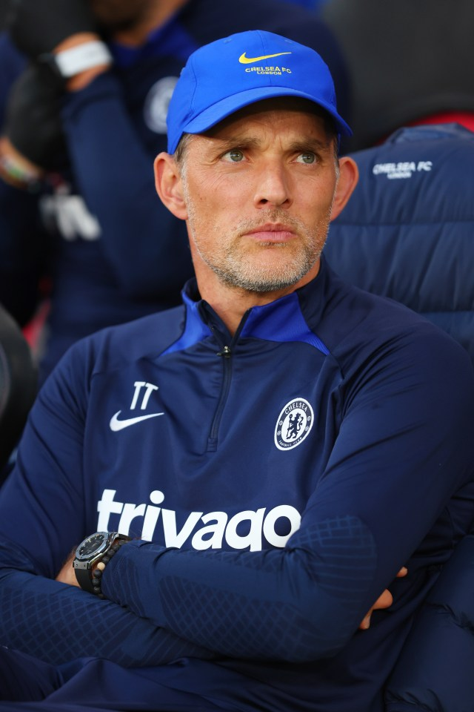
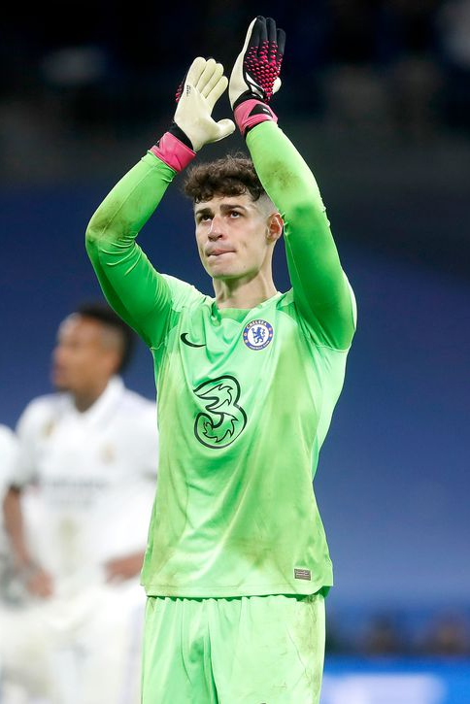
Example
“ So we had some statistics, we were well prepared, that Kepa is the best in percentage in saving penalties. ”
Thomas Tuchel,
Former Chelsea Football Club Manager
Kepa saved two penalties!
Kepa Arrizabalaga,
Chelsea Football Club Goalkeeper
Notes:
o For example, when Thomas Tuchel, former Chelsea Football Club manager, was asked why he brought on goalkeeper Kepa Arrizabalaga late into extra time, he responded, “So we had some statistics, we were well prepared, that Kepa is the best in percentage in saving penalties.” He added, “There is proof that Kepa is better at this discipline.” Chelsea went on to win the penalty shootout, with Kepa saving two penalties in the process. Although it may have played out differently in the scenario above, decisions backed by data on and off the field typically lead to more powerful and accurate decision-making.
§ Thomas Tuchel, former Chelsea Football Club manager : https://www.google.com/url?sa=i&url=https%3A%2F%2Fwww.the-sun.com%2Fsport%2F7706220%2Ftuchel-bayern-boss-nagelsmann-sacked%2F&psig=AOvVaw3IrxihX2vlGljZ10lmjiDQ&ust=1695605849808000&source=images&cd=vfe&opi=89978449&ved=0CA8QjRxqFwoTCLjq75SOwoEDFQAAAAAdAAAAABAE
§ Kepa Arrizabalaga Chelsea : https://www.google.com/url?sa=i&url=https%3A%2F%2Fweaintgotnohistory.sbnation.com%2F2022%2F10%2F20%2F23414120%2Fkepa-arrizabalaga-reaches-chelsea-clean-sheet-milestone-in-frustrating-draw&psig=AOvVaw2QV8p_sW7pzoYfqqq3moq5&ust=1695605940947000&source=images&cd=vfe&opi=89978449&ved=0CA8QjRxqFwoTCMiWocCOwoEDFQAAAAAdAAAAABAE
[SOURCE: https://www.datacamp.com/blog/sports-analytics-how-different-sports-use-data-analysis# ]

Slide 10
Analytics in Player Scouting and Recruitment
Scouting
Recruitment
Performance Analysis
Advanced Metrics
Video Analysis
Scouting Reports
Opponent Analysis
Comparative Analysis
Data-Driven Decision-Making
Predictive Analytics
Financial Analysis
Notes:
→ DS is supporting human-based scouting processes with technology and data-based processes - coming up with more reasonable and more accurate results.
Performance Analytics on an individual player level can serve as a foundation of salary optimization
quantification of the relative importance of different players to a team’s success

Slide 11
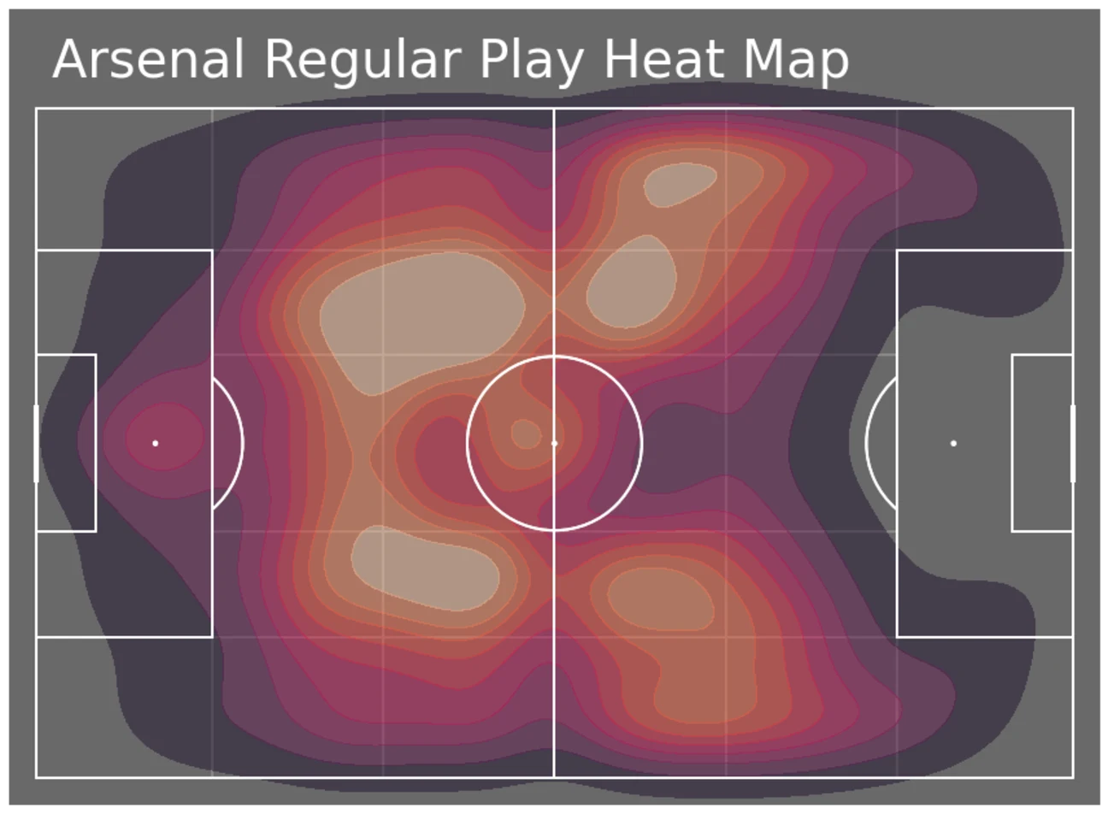
https://www.reddit.com/r/Gunners/comments/nikh9o/arsenal_regular_play_heat_map_premier_league/
Notes:
The image above is a Heat Map of Arsenal’s 2020/21 season. Using Analytical Data and Visualization techniques, it’s easy to see that Arsenal likes to play out from the back, passing the ball out to their defenders and eventually into the midfield.
They also rely quite a bit on their wingers, running the ball wide instead of preferring to take it through the center. When evaluating the opposition, the use of such Analytical Data becomes incredibly important. This data puts teams in a position to predict how the opposition might set themselves up for the match and how they prepare for different in-game situations.
Through the use of trusted insights and data collected across the course of the season, teams can better gauge their competition and tailor their strategy to neutralize their opponents. Data Science is now playing a significant role in helping teams increase their win ratio.
https://hevodata.com/learn/sports-data-analytics/

Slide 12
02
Player Health & Injury Analytics
Using descriptive factors (heart rate, blood pressure…) from frontier technology to:
Measure athletes’ physical condition (stress levels)
Analyze effect of different trainings
This avoids:
Salary is paid, even when player is injured
Team performance decreases
Injury risk reduction and faster recovery process
Notes:
The goal is to overcome the extremely high costs of player injuries.
Salary is paid, even when player is injured
Team performance decreases
Injury risk reduction and faster recovery process
Descriptive factors, such as heart rate and blood pressure allow to measure the physical condition of athletes can be drawn and stress levels can be derived
Descriptive analytics on player activity with the goal of analyzing the physical status and the effect of different trainings and game sessions
Frontier technology, such as the analysis of biometrics data, detailed biomechanics analyses, and video data,
******
Another application area of SA to be distinguished is Player Health and Injury analytics. Through these analytical operations teams try to overcome the extremely high costs which come along with player injuries. Not only has the salary to be paid, even while the player is injured, but also the team performance decreases for the time of the injury. Table stakes analytics for this area are using descriptive analytics on player activity with the goal of analyzing the physical status and the effect of different trainings and game sessions. Through the analysis of descriptive factors, such as heart rate and blood pressure, conclusions about the physical condition of athletes can be drawn and stress levels can be derived. The goal of analytics in this area, however, is the prediction and prevention of injuries. This is a very challenging task for sports teams, as injuries can be caused by many different factors and are, up to a certain degree, unpredictable. However, using frontier technology, such as the analysis of biometrics data, detailed biomechanics analyses, and video data, a reduction of the injury risk, and a faster recovery process through the application of the right treatment methods can be achieved. Although first programs reducing the injury risk already exist, for example the FIFA 11 and 11+ programs(https://jacobstirtonmd.com/wp-content/uploads/2019/07/The-FIFA-11-Soccer-Injury-Prevention-Program.pdf), a further move towards the application of more predictive analytics in this area is to be expected for the future (Davenport, 2014a; Thorborg et al., 2017).

Slide 13
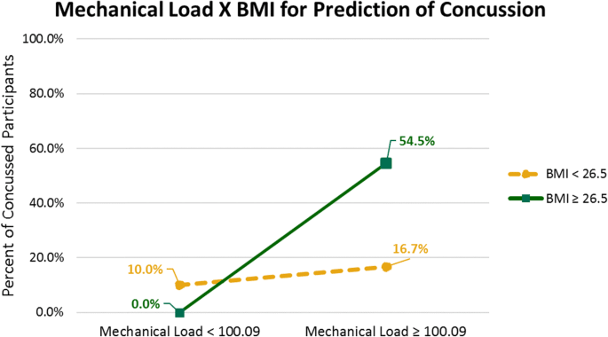
Example: Zephyr BioHarness Wearable Technology
→ Predict and prevent injuries based on overall mechanical load and BMI
Results:
Identify players with higher injury risk
Balance overall exertion levels
Enroll in conditioning programs
https://link.springer.com/article/10.1007/s10796-020-10018-3
Notes:
This study finds that a combination of high BMI and high mechanical loads could result in injury. Therefore, in creating an exercise program, it is imperative to ensure that mechanical load is incrementally increased through the practice season as athletes become conditioned. While, a high level repetitious mechanical load with unconditioned athletes could cause injuries in short time, it is important to impose enough mechanical loads in the training program to ensure good musculoskeletal development.
In summary, results from this study demonstrate that wearable technology allows players with an increased risk of injury to be identified and targeted for intervention.
The use of wearable technologies in sports is increasing, and this makes Sports Data Analytics much more predictable. As you can see in the graph, a study was conducted using Zephyr BioHarness Wearable Technology to gain a more comprehensive insight on how to predict and prevent injuries by assessing the overall mechanical load and the BMI of the wearer.
This can help identify players with a higher risk of injury, allowing fitness staff to balance their overall exertion levels and enroll them in conditioning programs if needed. The use of Logarithmic Regression models via Binomial Distribution is commonly used to assess the probability of player injuries.
Using multiple platforms and comprehensive analysis software, analysts can obtain Neuromuscular data and store it in a Data Warehouse. This data can be tracked throughout the season to identify changes. Deviations can be identified using Convolutional Neural Networks (CNN).
https://hevodata.com/learn/sports-data-analytics/

Slide 14
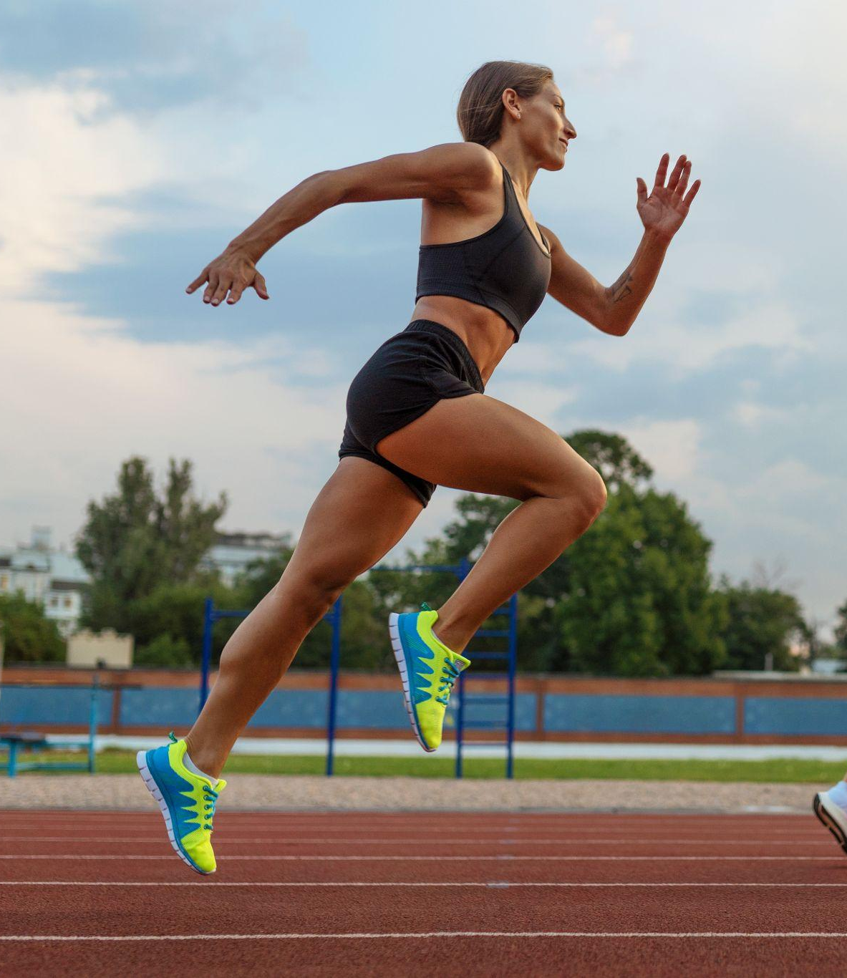
Sports Analytics: Player Development & Injury Prevention
Ways in which analytics contribute to player development and injury prevention:
Performance Monitoring
Individualized Training Plans
Load Management
Biomechanical Analysis
Injury Risk Assessment
Player Tracking Wearables
Video Analysis
Rehabilitation Monitoring
Nutritional Guidance
Longitudinal Tracking

Slide 15
03
Business Analytics
Ticket Pricing models: Static vs. Dynamic Pricing
Increasing Fan Engagement:
Sport-related behaviors
Impression-management behavior
Relationship-building behaviors
Non-transactional extra role behaviors
Notes:
Ticket Pricing models: Static vs. Dynamic Pricing
Increasing Fan Engagement:
Sport-related behaviors (attending matches, watching matches, reading articles, purchasing merchandise)
Impression-management behavior
Relationship-building behaviors (season-ticket purchase, loyalty program participation)
Non-transactional extra role behaviors (social interaction, word-of-mouth)
****
the ticket pricing remains static throughout the complete season, but various games, for example against popular or successful opponents, are charged a higher ticket price (Davenport, 2014a). A more sophisticated and less widely spread approach to ticket pricing is dynamic pricing. Dynamic pricing was first identified as an appropriate pricing strategy for professional football clubs by Nufer and Fischer(2013). It includes ticket price changes throughout the season, based on several factors, such as the current performance of the team, league standings, the weather, and hundreds of more factors. An AI-driven pilot project of Vitesse Arnhem in which dynamic pricing methods were applied in the Dutch Eredivisie seemed to proof valuable for the football club and appreciated by the fans.
attempts to increase the fan engagement. Fan engagement hereby describes the different behaviors in which sport consumers engage with their teams. These behaviors can include sport-related behaviors (attending matches, watching matches, reading articles, purchasing merchandise), impression-management behavior, relationship-building behaviors (season-ticket purchase, loyalty program participation), and non-transactional extra role behaviors (social interaction, word-of-mouth). In general, fan engagement management is comparable to customer engagement management in other business sectors (Yoshida et al., 2014). While table stakes analytical operations try to increase the fan engagement by the sole display of statistics, videos, and other club-based content on the websites, frontier applications in this field aim at personalizing the online content based on the available fan information. These applications are based on the evaluation of Social Media data about the fans in combination with membership data (Davenport, 2014a). Vale and Fernandes (2018), for example, identify the different motives and dimensions related to online engagement behaviors and derive additional opportunities for managers to engage online with their fans. Combining online and membership data further increases the possibilities of clubs to engage with their fans, by developing increasingly targeted marketing approaches based on a fan’s history, past purchases, and online interaction. Like this, not only the marketing can be personalized and optimized by applying fan-oriented and fan-specific promotions, but also the various activities before and after games can be controlled (Davenport, 2014a). FC Bayern Munich, for example, shows how they transport digitally generated data about fans to their offline fan shop in order to better meet customers’ demands and increase the fan shop revenue, with the help of the software company SAP (SAP Sports and Entertainment, 2018).

Slide 16
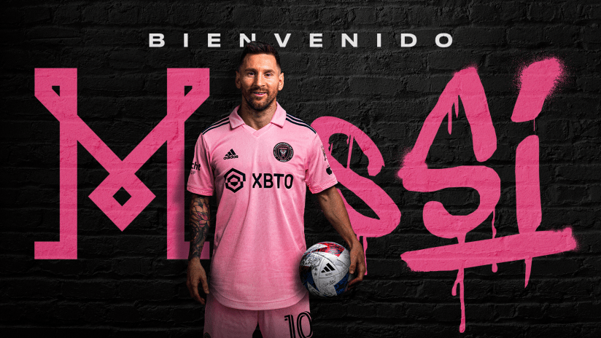
Inter Miami starting ticket price before Messi: $31
Inter Miami starting ticket price after Messi: $252
https://www.intermiamicf.com/news/inter-miami-cf-signs-seven-time-ballon-d-or-winner-world-cup-champion-lionel-mes
https://khelnow.com/football/2023-08-world-football-inter-miami-ticket-prices-before-and-after-lionel-messi
Notes:
The image above is a Heat Map of Arsenal’s 2020/21 season. Using Analytical Data and Visualization techniques, it’s easy to see that Arsenal likes to play out from the back, passing the ball out to their defenders and eventually into the midfield.
They also rely quite a bit on their wingers, running the ball wide instead of preferring to take it through the center. When evaluating the opposition, the use of such Analytical Data becomes incredibly important. This data puts teams in a position to predict how the opposition might set themselves up for the match and how they prepare for different in-game situations.
Through the use of trusted insights and data collected across the course of the season, teams can better gauge their competition and tailor their strategy to neutralize their opponents. Data Science is now playing a significant role in helping teams increase their win ratio.
https://hevodata.com/learn/sports-data-analytics/

Slide 17

FC Bayern Munich Perfects the Fan Experience with Digital Solutions
Goal: build a bond with supporters outside the stadium and create additional experiences for them
How?
Through SAP HANA - customer data is combined in a ‘Golden Fan Record’ (+250 attributes)
Anticipating fan wishes and utilizing existing capacities
Notes:
more than 250 fan attributes and enables us to create target group-specific content, services, and marketing campaigns, for example, for fan merchandise,”
The team from Munich also relies on SAP Analytics Cloud to enable comprehensive analyses of customer data in a single click. The company is provided with real-time heat maps and dashboards containing the key indicators for all relevant customer groups and business areas.
Win-Win: Anticipating Fan Wishes and Utilizing Existing Capacities
The club uses the insights gained to offer its fans attractive deals. “Cross-marketing in real time is made possible by SAP solutions,” reports Mennerich. “If a product is currently unavailable, the fan immediately receives a suitable alternative offer. And, for example, our members receive a fan shop voucher on their birthday.”
An additional advantage for club members is that, thanks to digital solutions, they can maintain their master data independently and without having to make a detour via the club’s call center. Within one year, FC Bayern registered over 160,000 online updates by members that would have otherwise had to be handled by employees, who can now focus on other tasks.
For Mennerich, the advantages of digitalization are obvious: “In the online shop, the revenue from new customers, the shopping cart value, and sales via mobile devices have increased significantly. With SAP, we are both inspiring the fans and expanding our business.”
https://news.sap.com/2020/07/fc-bayern-munich-fan-experience-solutions/

Slide 18
02
What are some of companies/research groups working in sports?
Notes:
What are some of companies/research groups working in this area?
i. Are there any ongoing research projects or collaborations between academic institutions and sports organizations in the field of sports analytics?
2. How are they using data science?

Slide 19
Companies
Prozone Sports
Genius Sports
Sportradar
Prozone Sports Ltd, a pioneer in performance analysis for 19 years, collaborates with top sports clubs and organizations to provide world-leading performance analysis services.
London-based Genius Sports specializes in sports data, betting, and media tech. Trusted in 150+ countries, they partner with 400+ global sports organizations, such as NFL, EPL, and FIBA.
Sportradar is a Silicon Valley technology startup that developed an analytics platform to interpret the data and provide relevant, actionable information to the team staff.

Slide 20
How Data Science iS Used
Data Collection
Convolutional Neural Network
Sources
Cameras, Gps, Wearable devices, etc.
Prediction
Regression Model
Performance
Classification Model
Customer Retention
Logistic Regression
Salary
Multivariate Regression
Buzz
NLP
Referee Decision Analysis
Decision Tree

Slide 21
03
Data Scientist in Sports:
Daily Role & Ethical Challenges?
Notes:
• What is a typical day-to-day of a data scientist in this domain
What are the challenges and ethical considerations associated with collecting and using player data in sports analytics?
Articles and interviews

Slide 22
Day-to-day Activities
Specialization in a Sport or Team
Communication
Data-Driven Research and Analysis

Slide 23
Day-to-Day in Sports
Golf and basketball
Football company
Analyzing data
Setting up the infrastructure
Pipeline monitoring
Scouting reports
Explain Blackbox ML solutions to football experts

Slide 24
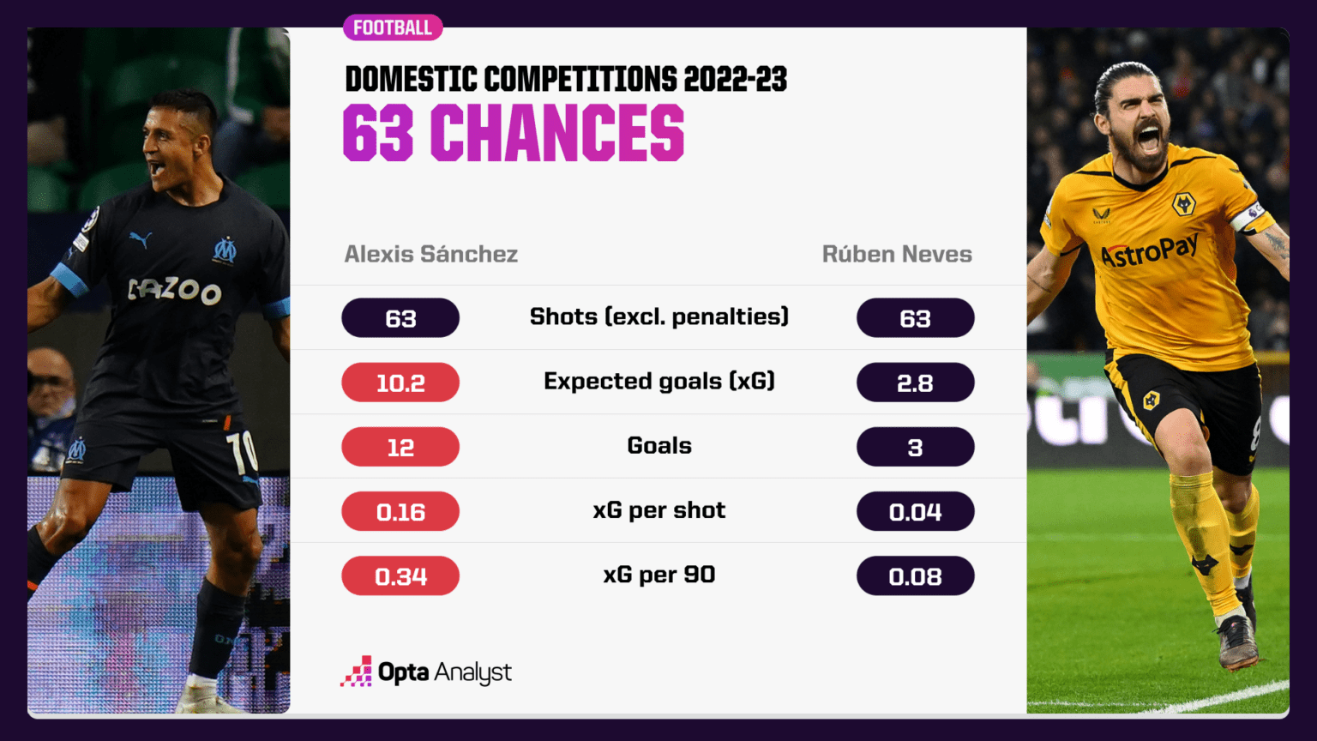
Metrics
XG - Expected Goals
https://theanalyst.com/na/2023/08/what-is-expected-goals-xg/#:~:text=Since%20xG%20was%20introduced%20in,and%20insightful%20within%20football%20analytics.
Notes:
The image above is a Heat Map of Arsenal’s 2020/21 season. Using Analytical Data and Visualization techniques, it’s easy to see that Arsenal likes to play out from the back, passing the ball out to their defenders and eventually into the midfield.
They also rely quite a bit on their wingers, running the ball wide instead of preferring to take it through the center. When evaluating the opposition, the use of such Analytical Data becomes incredibly important. This data puts teams in a position to predict how the opposition might set themselves up for the match and how they prepare for different in-game situations.
Through the use of trusted insights and data collected across the course of the season, teams can better gauge their competition and tailor their strategy to neutralize their opponents. Data Science is now playing a significant role in helping teams increase their win ratio.
https://hevodata.com/learn/sports-data-analytics/

Slide 25
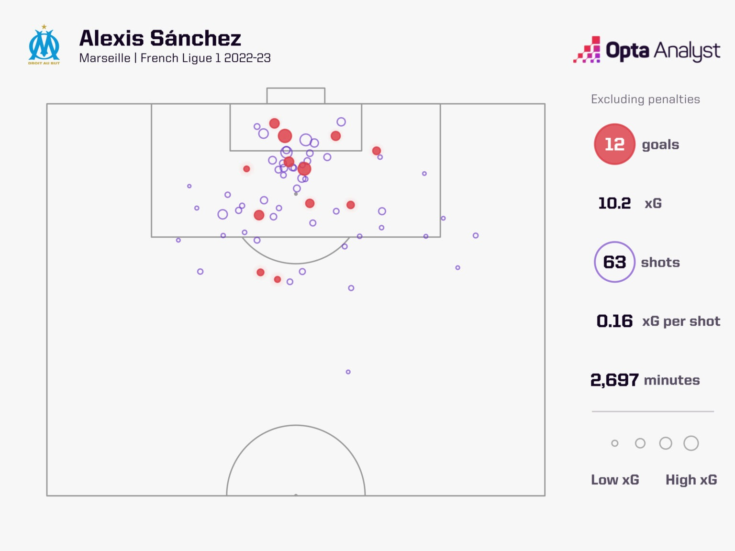
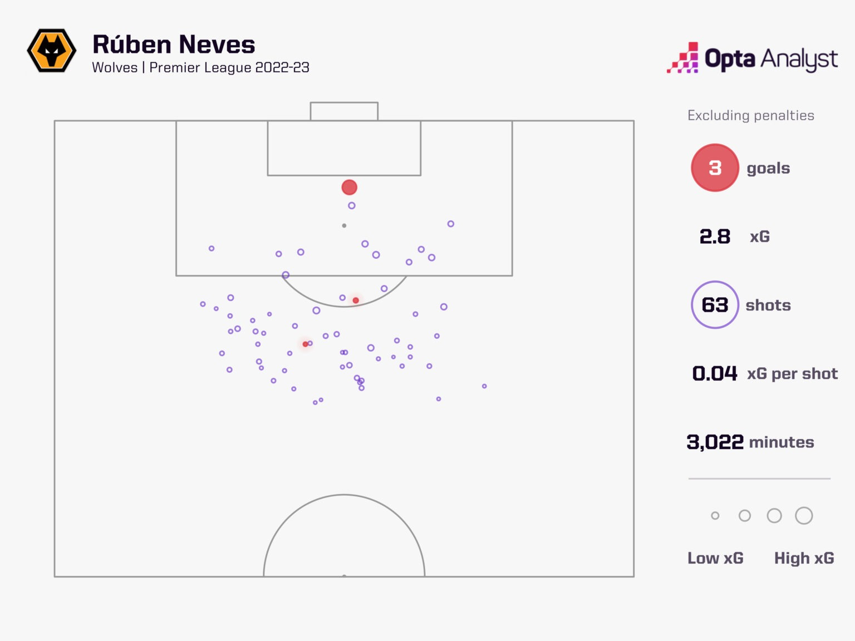
XG - Expected Goals
https://theanalyst.com/na/2023/08/what-is-expected-goals-xg/#:~:text=Since%20xG%20was%20introduced%20in,and%20insightful%20within%20football%20analytics.
Notes:
The image above is a Heat Map of Arsenal’s 2020/21 season. Using Analytical Data and Visualization techniques, it’s easy to see that Arsenal likes to play out from the back, passing the ball out to their defenders and eventually into the midfield.
They also rely quite a bit on their wingers, running the ball wide instead of preferring to take it through the center. When evaluating the opposition, the use of such Analytical Data becomes incredibly important. This data puts teams in a position to predict how the opposition might set themselves up for the match and how they prepare for different in-game situations.
Through the use of trusted insights and data collected across the course of the season, teams can better gauge their competition and tailor their strategy to neutralize their opponents. Data Science is now playing a significant role in helping teams increase their win ratio.
https://hevodata.com/learn/sports-data-analytics/

Slide 26
Challenges & Ethics
Challenges
Ethical Considerations
Privacy Concerns
Informed Consent
Data Security
Data Ownership
Fair Use
Transparency
Data Retention
Bias Mitigation
Accountability

Slide 27
04
What are the skills that a data scientist should have when working in this domain?
Notes:
What skills are essential for a data scientist or analyst working in sports analytics?
Are there any specialized tools or software commonly used in this field?
How can aspiring data scientists or students interested in sports analytics get involved in this field?

Slide 28
Essential Skills
Statistical Analysis
Machine Learning
Data Manipulation
Sports Knowledge
Data Visualization
Domain-Specific Metrics

Slide 29
Specialized Tools
Data Collection
Analytics
Visualization Tools
Stats Perform
Sportradar
Opta
FBref
Sports Insights
Sportscode
Catapult Sports
Tableau
Power BI
QlikView

Slide 30
How to get Involved?
Gain Sports Knowledge
Build Portfolio
Join Sports Analytics Communities
Attend Conferences
and Workshops
Reddit Communities
Sports Analytics: for nerds who love sports
MIT Sloan Sports Analytics Conference

Slide 31
05
What are some courses that you could take at CU or elsewhere?
Notes:
• What are some elective courses that a students interested in this domain could take at CU? (I strongly suggest you include this question)

Slide 32
COURSES AT CU
LEEDS SCHOOL OF BUSINESS
Leeds School of Business offers a 9-credit "boot camp" for sports and recreation enthusiasts, covering topics like sports analytics.
DIGITAL IMAGE PROCESSING
Course teaches the fundamental techniques for image representation and compression.
NEURAL NETWORK AND DEEP LEARNING
Learn to design neural network architectures and training procedures
MACHINE LEARNING
The curriculum encompasses mathematics, statistics, machine learning, ethics, and societal aspects to provide a holistic education.

Slide 33
OTHER COURSES
UNIVERSITY OF MICHIGAN
This sports online analytics course uses real data from various sports leagues to teach predictive modeling, machine learning, and data analysis to sports enthusiasts, professionals, and Python learners.
SYRACUSE UNIVERSITY
Syracuse University's sport analytics program educates students on the principles of research methodology, sport economics, database management, finance, computer mathematics, statistics and economics.
GEORGE MASON UNIVERSITY
Courses in sport analytics provide students with a foundational understanding of the sport industry coupled with the study of how data can be used in the world of sport to enable teams, leagues, and other sports businesses to gain an advantage over their competitors.

Slide 34
REFERENCES
https://www.discoverdatascience.org/industries/sports/
https://www.indeed.com/career-advice/career-development/types-of-software
https://sweepsportsanalytics.com/2021/08/01/10-steps-to-get-started-in-sports-analytics/
https://www.datacamp.com/blog/sports-analytics-how-different-sports-use-data-analysis#
https://www.grandviewresearch.com/industry-analysis/sports-analytics-market
https://hevodata.com/learn/sports-data-analytics/
https://sportsanalytics.blog/2021/09/01/the-three-application-areas-of-sports-analytics/
https://www.analyticsvidhya.com/blog/2023/08/sport-analytics/
https://link.springer.com/article/10.1007/s10796-020-10018-3
https://news.sap.com/2020/07/fc-bayern-munich-fan-experience-solutions/

Slide 35

THANKS!
DO YOU HAVE ANY QUESTIONS?
Scan to get resources

